Slide 1
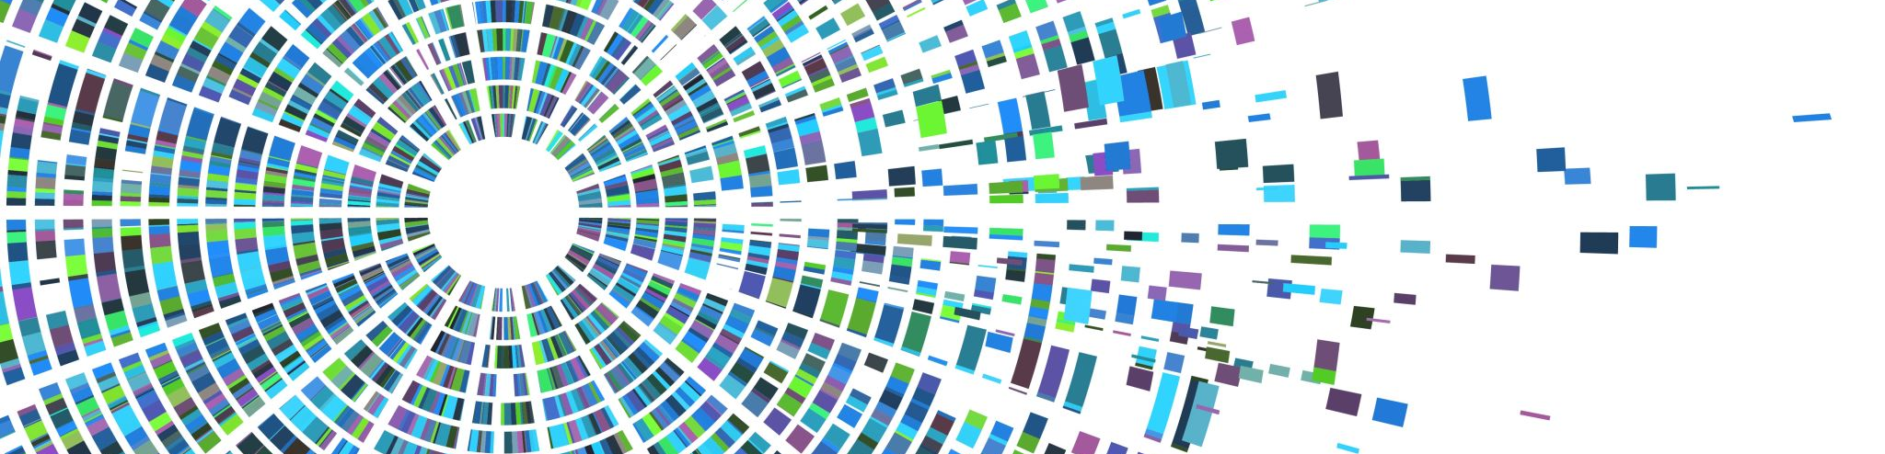
Introduction to Open Scholarship for Career Progression
Dr Javiera Atenas
School of Business, Arts, Social Sciences and Technology

Slide 2
Demonstrating Commitment to Open Research Practices
Open scholarship is about practice, not only outputs
Evidence can include:
Making publications and presentations openly accessible
Sharing data, code, protocols or teaching resources
Using preprints and repositories for papers and data
Engaging communities within and beyond academia
Adopting FAIR and ethical data practices
Using AI transparently and responsibly
Contributing to collaborative and interdisciplinary research

Slide 3
Why?
CoARA has outlined ten commitments for its signatories:
Recognise the diversity of contributions to research and research careers, reflecting the specific needs and nature of the research.
Prioritise qualitative evaluation in research assessment, with peer review as the central method, supplemented by responsible use of quantitative indicator.
Eliminate the inappropriate use of publication metrics like Journal Impact Factor (JIF) and h-index in research evaluation.
Avoid using rankings of research organisations in assessment processes.
Allocate adequate resources to support reform in research assessment and drive organisational change.
Continuously review and improve research assessment criteria, tools, and methods.
Raise awareness and provide clear guidance on research assessment reforms, ensuring transparency in criteria and processes.
Share experiences and best practices within and outside the coalition to foster mutual learning.
Report progress on implementing the commitments and adhering to CoARA’s principles.
Ensure research assessment practices are informed by evidence and make data publicly available for evaluation and analysis.
The University of Suffolk has officially signed the Coalition for Advancing Research Assessment (CoARA), a European-led initiative with global outreach.
CoARA envisions an assessment system that recognises the variety of contributions, activities, and practices that drive research quality and impact. It emphasises qualitative judgments, with peer review playing a crucial role, and supports this with the responsible use of quantitative metrics.
By signing the CoARA Agreement, the University of Suffolk demonstrates its commitment to reforming research assessment in alignment with CoARA's principles and takes on the obligation to implement these changes.
UOS – COARA Info

Slide 4
What Open Outputs Might You Already Have?
Activity | Open Scholarship Contribution
Open Access article | Open dissemination
Repository deposit | Knowledge accessibility
Shared dataset | Open data
Teaching toolkit | OER
ORCID profile | Research infrastructure
GitHub repository | Open methods
Public lecture | Public engagement
Policy brief | Societal impact
Workshop materials | Open educational practice
Community partnership | Knowledge exchange
Preprint | Early dissemination

Slide 5
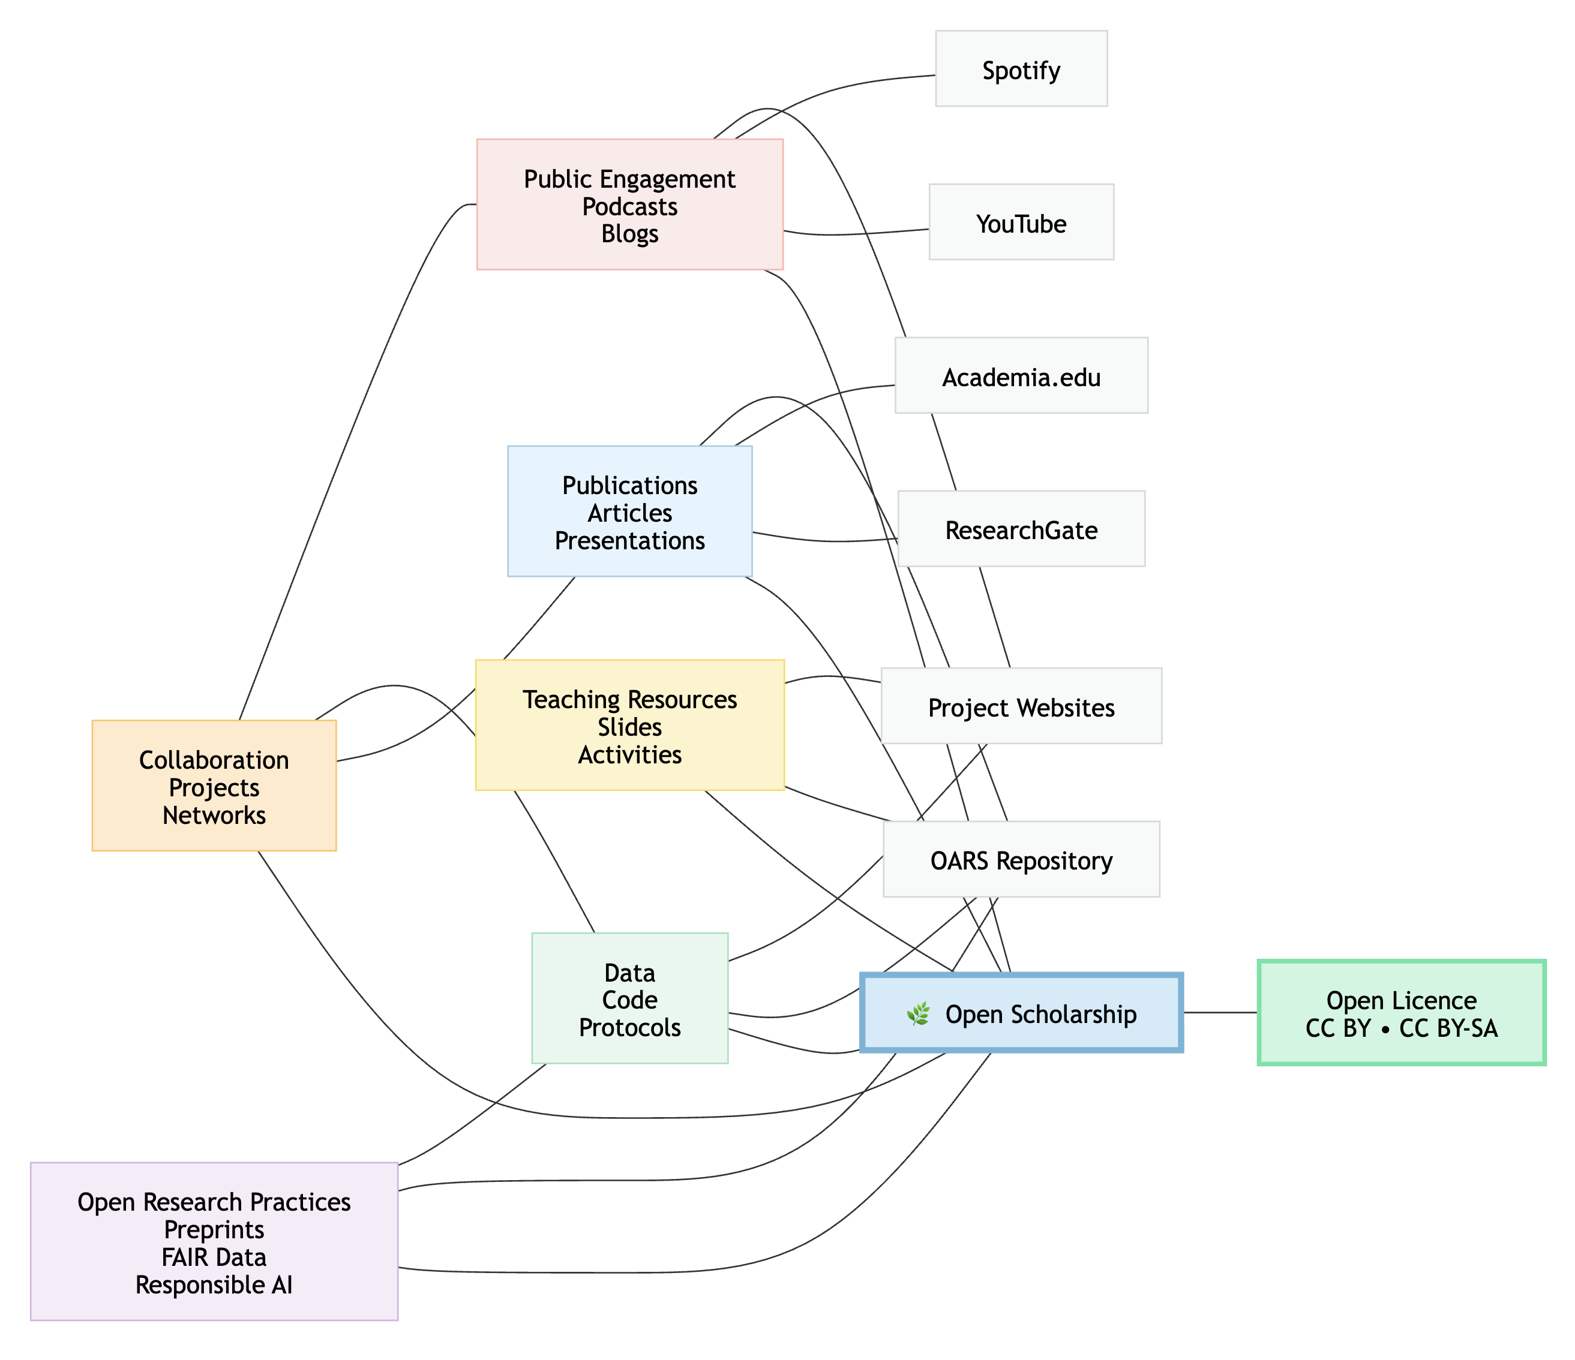
So if You may have it already… Just make it open

Slide 6
Open Access Publications
Example
A lecturer deposits their accepted manuscript in the institutional repository and can demonstrate downloads from multiple countries and citations in subsequent studies.
✅ Publishing in Open Access journals
✅ Depositing accepted manuscripts in institutional repositories
✅ Publishing books or chapters under open licences
✅ Sharing conference papers openly
Evidence for progression
Downloads and views
Citations
International readership
Practitioner uptake
Policy influence
https://ccucsac.sharepoint.com/sites/Hub-researchoffice/SitePages/Sharing-Research-Outputs-and-Publications.aspx

Slide 7
Licensing, Copyright and Responsible Sharing
Before Uploading Any Resource
Always consider ownership, copyright and licensing requirements.
Check:
✓ Does the resource contain third-party content?
✓ Does it contain personal or sensitive data?
✓ Have collaborators agreed to sharing?
✓ Is the resource suitable for open release?
Licensing
Where appropriate, select an open licence that clearly communicates reuse permissions, for example Creative Commons:
CC BY
CC BY-SA
CC BY-NC
University of Suffolk Materials
For resources created as part of your employment, colleagues should ensure that repository deposits and licensing arrangements comply with University policies and contractual requirements regarding intellectual property and copyright ownership.

Slide 8
Creative Commons Licences
Licence | What it Allows
CC BY | Reuse and adaptation with attribution
CC BY-SA | Reuse and adaptation with attribution; derivatives must use the same licence
CC BY-NC | Reuse and adaptation for non-commercial purposes
CC BY-ND | Redistribution only; no modifications
The Most Common Open Licences
Creative Commons licences allow others to use your work under specified conditions.
See more: Creative Commons Licences https://github.com/Digital-Future-Institute/CoARA/blob/main/2.1-Creative-Commons-Licences.md

Slide 9
Beyond Creative Commons: Other Open Licensing Schemes
Type of Output | Typical Licence
Software and Code | MIT, Apache 2.0, GPL
Research Data | CC0, Open Data Commons
Databases | Open Database Licence (ODbL)
Educational Resources | CC BY, CC BY-SA
Publications | CC BY
Different Outputs May Require Different Licences
Creative Commons licences work well for publications, presentations and teaching resources, but other outputs often use specialist licences.
See more: Other licensing schemes https://github.com/Digital-Future-Institute/CoARA/blob/main/2.2-Other-open-licensing-schemes.md

Slide 10
Publications Are Not the Same as Software
Licensing schemes
Software
MIT
Apache 2.0
GPL
Data
CC0
Open Data Commons licences
You can share:
Code
Scripts
Computational notebooks
Datasets
Databases
Visualisation tools

Slide 11
Open Licensing = Clear Permission
Why Licence Your Work?
Sharing a resource does not automatically tell others what they can do with it.
A licence provides clear written permission for reuse.
Remember
The author remains the creator.
The copyright holder retains copyright.
The licence does not transfer ownership.
The licence simply explains how others may use the work.
Learn More
Open Licensing in Open Science https://github.com/Digital-Future-Institute/CoARA/blob/main/2.-Open-Licensing-in-Open-Science.md

Slide 12
Diverse Research Outputs
Not all valuable scholarship appears as journal articles.
Examples
Datasets
Software
Code
Policy briefs
Open Educational Resources
Toolkits
Reports
Visualisations
Artistic works
Public resources
Training materials

Slide 13
Preprints as Open Outputs
Evidence
DOI and repository record
Downloads
Citations before journal publication
Online discussion
Why they matter
Early dissemination of research
Establishing priority
Encouraging peer feedback
Increasing visibility
Example
A researcher uploads a preprint to SocArXiv or OSF and receives feedback that strengthens the final article.

Slide 14
Open Data and FAIR Data
Sharing research data
Researchers can demonstrate openness by:
Depositing datasets
Creating metadata records
Publishing data management plans
Using FAIR principles
Evidence
Dataset DOI
Downloads and reuse
Citations to datasets
Data repository metrics

Slide 15
Opening Qualitative Research
Open does not always mean publicly available
Researchers may:
Share interview schedules
Share coding frameworks
Provide metadata
Publish anonymised extracts
Share methodological documentation
Evidence
Repository records
Research transparency statements
Documentation demonstrating responsible sharing

Slide 16
Open Educational Practices
Many academics already do this
Examples include:
Sharing teaching resources
Creating Open Educational Resources (OER)
Publishing guides and workshops
Developing openly licensed learning materials
Contributing to professional communities
Evidence
Resource download
Adoption by other institutions
Invitations to deliver workshops
Peer recognition

Slide 17
Open Methods and Open Code
Evidence
GitHub repositories
Software citation
Forks and contributions
Community engagement
What counts?
Sharing methodologies
Publishing protocols
Making code available
Sharing analytical workflows
Publishing visualisation scripts
Example
A researcher shares an R script used in an article, enabling replication by others.

Slide 18
Community Engagement and Public Scholarship
Evidence
Attendance figures
Testimonials
Policy citations
Media engagement
Partnership records
Examples include:
Working with schools
Public talks
Citizen science projects
Collaborations with NGOs
Policy engagement
Professional body contributions
Example
A researcher shares an R script used in an article, enabling replication by others.

Slide 19
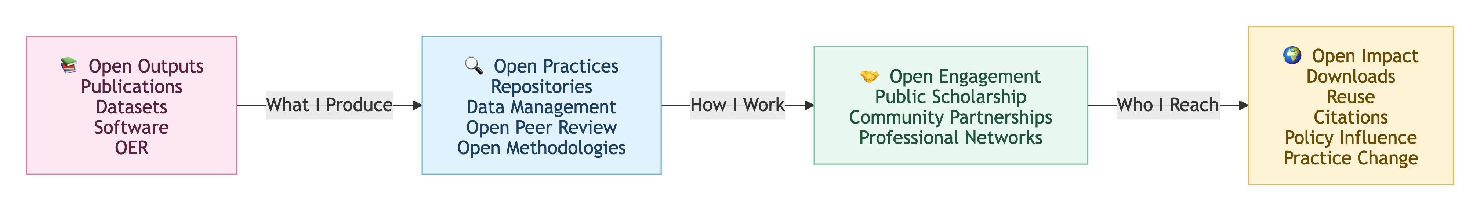
Building an Open Scholarship Portfolio
Open scholarship can be evidenced through four complementary dimensions: what you produce (outputs), how you work (practices), who you engage (engagement), and the difference your work makes (impact). Together, these provide strong evidence for promotion, academic progression, narrative CVs, and CoARA-aligned research assessment.

Slide 20
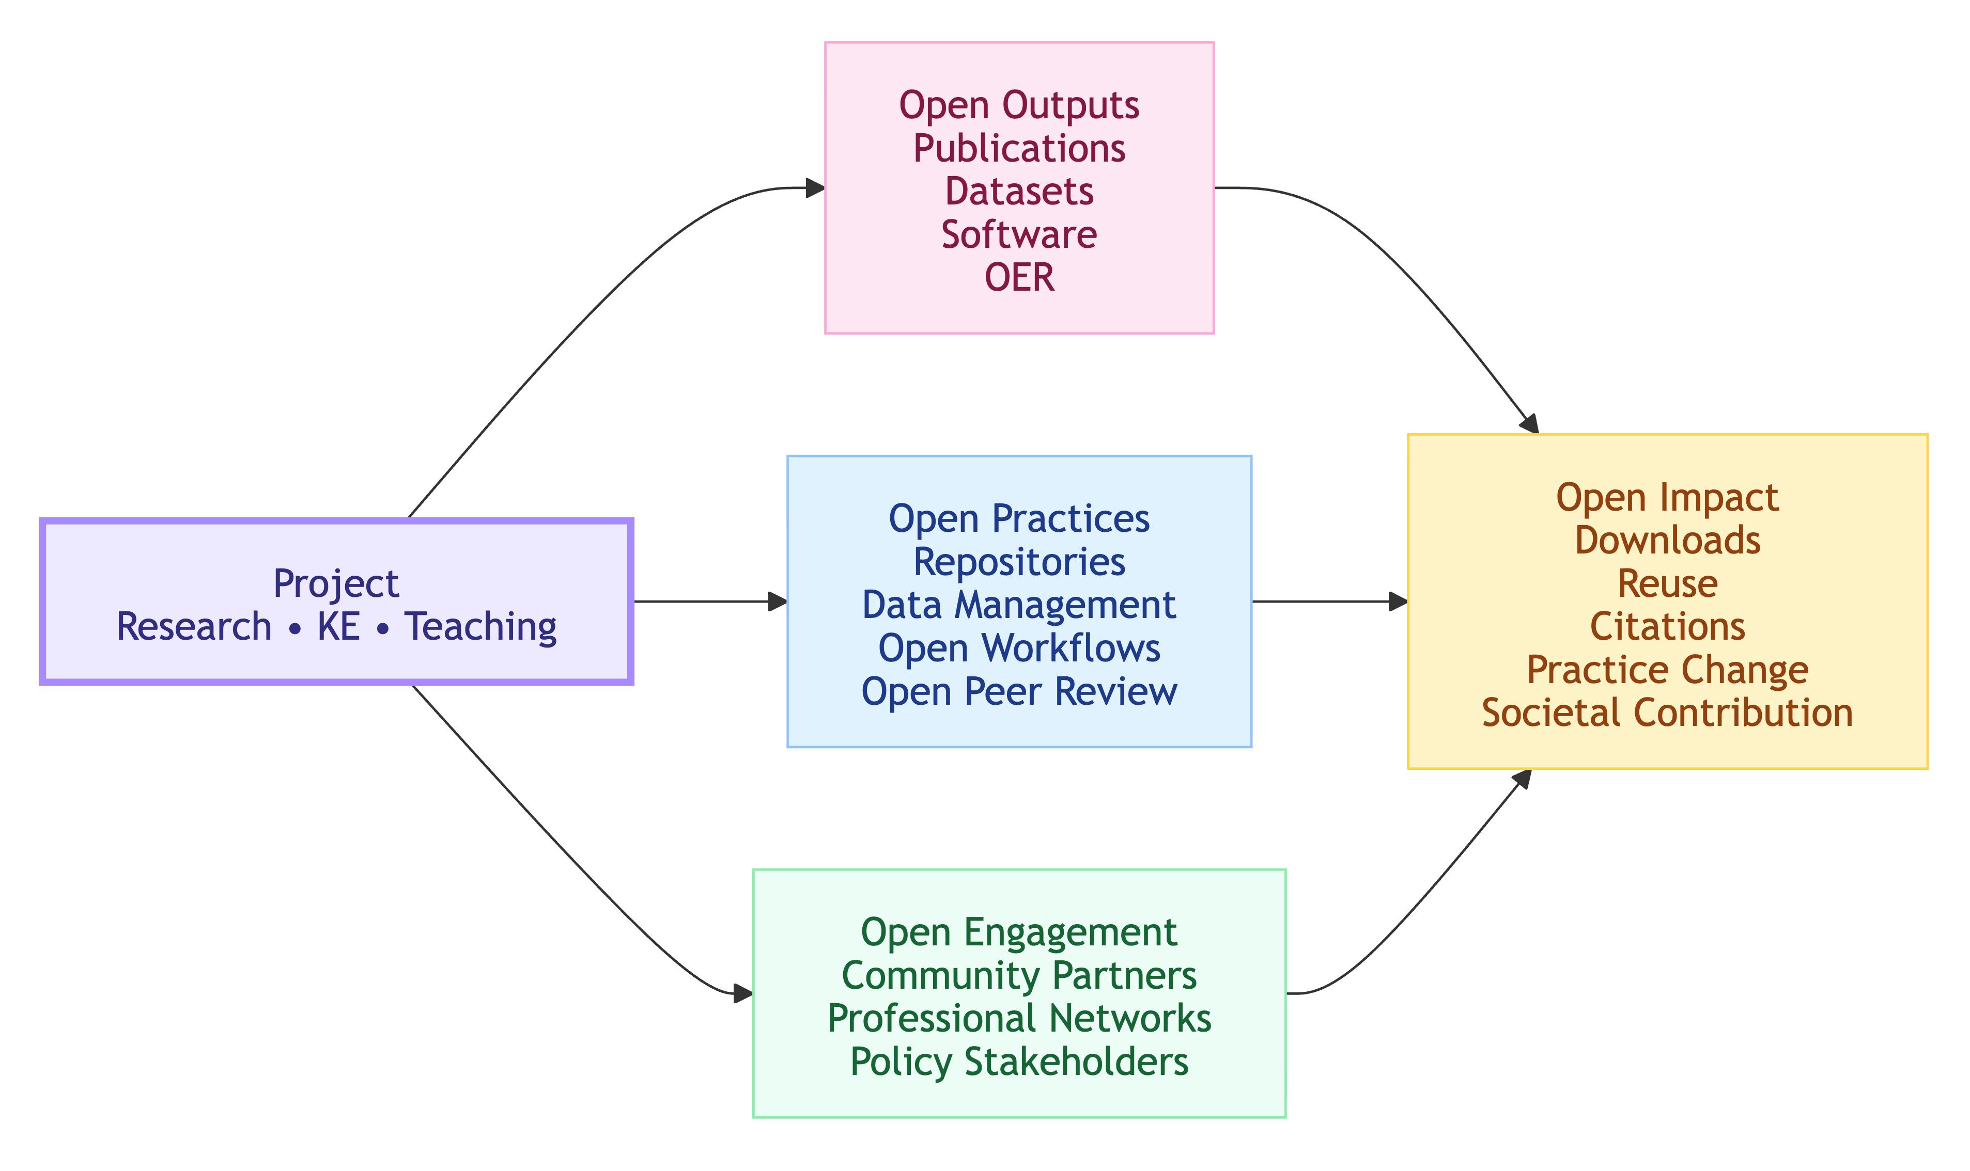
Building an Open Scholarship Portfolio

Slide 21
Audit Your Existing Outputs
You May Have More Open Outputs Than You Think
Review your professional portfolio and identify materials that could be openly shared.
Consider:
Journal articles and conference papers
Datasets and research instruments
Software, scripts and visualisations
Conference presentations and keynote slides
Training guides and workshop materials
Teaching resources
Podcasts, webinars and recorded talks
Blogs, newsletters and public scholarship outputs
Interviews and media contributions
Policy briefs and consultancy reports
Activity
Create a list of outputs produced during the last five years and categorise them under:
Open Outputs
Open Practices
Open Engagement
Open Impact

Slide 22
Make Your Work Discoverable
OARS (University of Suffolk Repository)
Suitable for:
Publications
Presentations
Reports
Learning resources
Conference materials
Repository: https://oars.uos.ac.uk/
Zenodo
Suitable for:
Datasets
Software
Training materials
Research instruments
Presentations
Multimedia outputs
Repository: https://zenodo.org/

Slide 23



To learn more about open scholarship practices visit: https://github.com/Digital-Future-Institute/CoARA
And visit the UOS-COARA resource hub
Any questions: Contact j.atenas@uos.ac.uk

