Slide 1
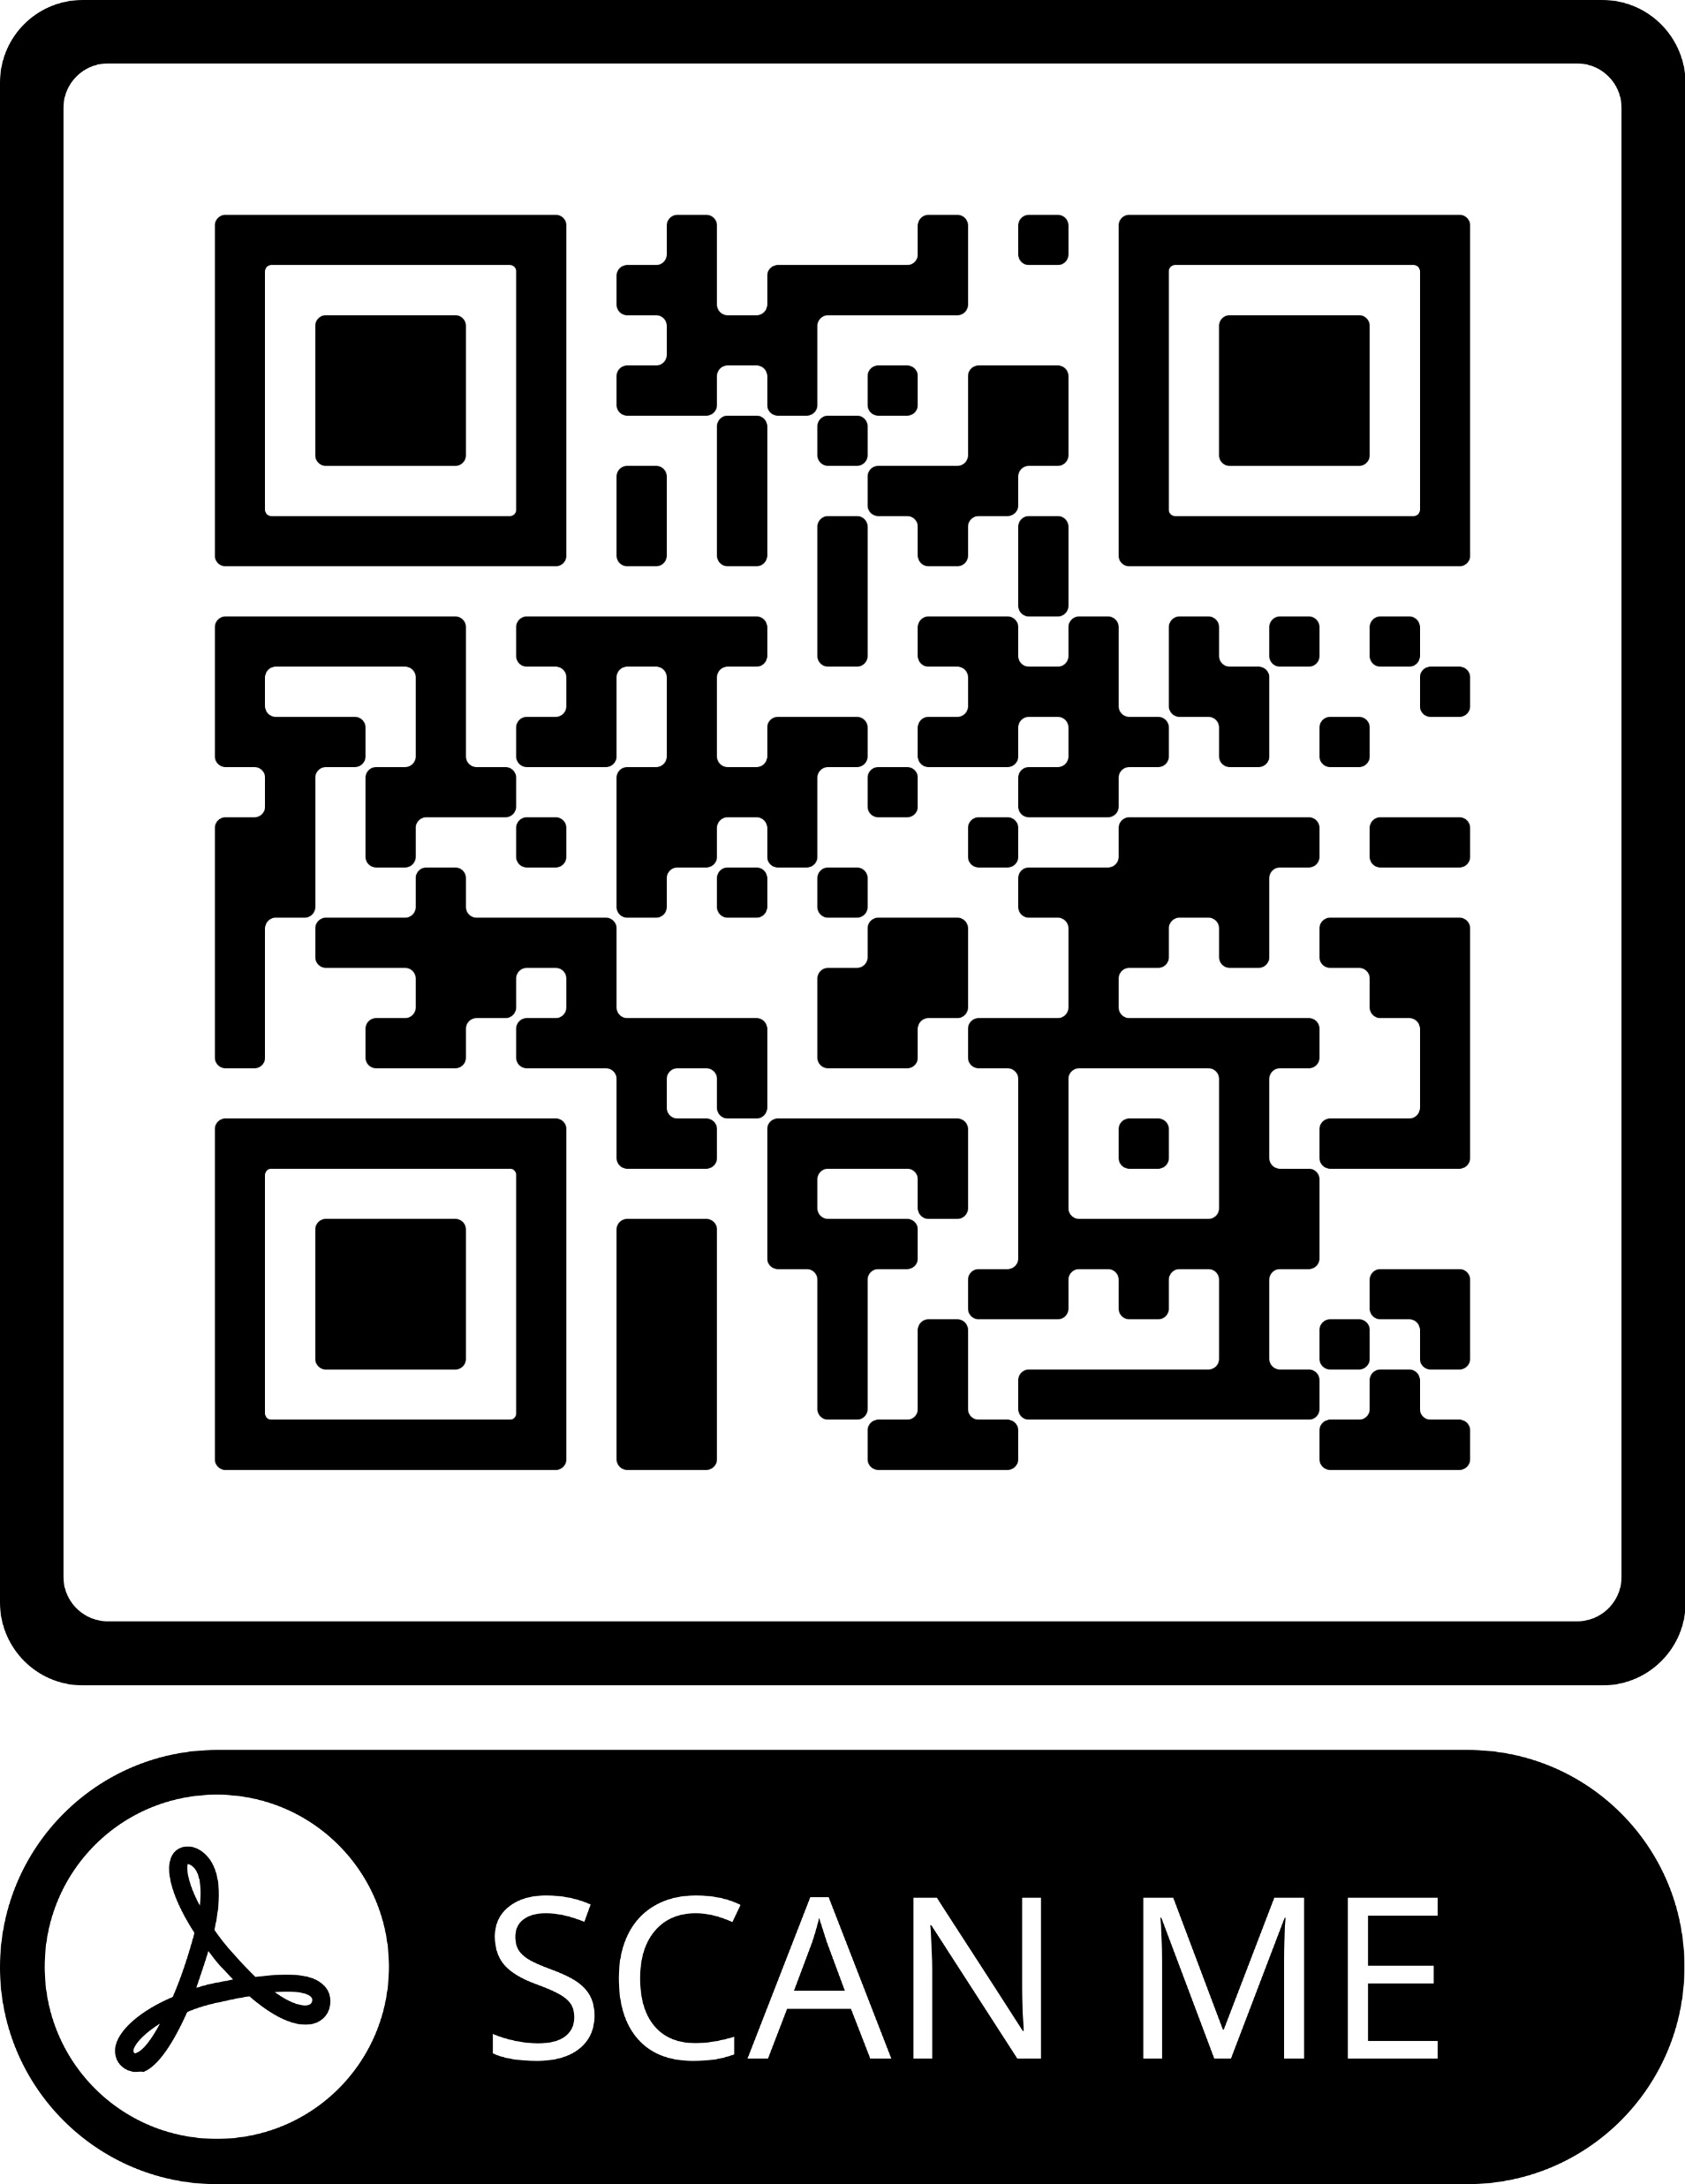
Nursing students’ attitudes on caring for people living with HIV/AIDS in the UK: A cross sectional study
Dr Theodora Stroumpouki (1) | Dr Areti Stavropoulou (2) | Carmela Triglia (3) | Emanuele Vizilio (4) | Dr Dimitrios Papageorgiou (2) | Dr Ivan Rubbi (5) Dr Antonio Bonacaro (6) (2)
(1) Kingston University, London, UK, (2) University of West Attica, Athens, Greece, (3) Ferrara Hospital, Ferrara, Italy, (4) Bologna Hospital, Bologna, Italy, (5) University of Bologna, Bologna, Italy, (6) University of Suffolk, Ipswich, UK
AAS LEVEL OF AGREEMENT
BACKGROUND
Caring for people living with HIV (PLWH) and AIDS is a complex and constantly evolving issue. Despite nursing students have relatively sufficient knowledge on HIV infection they may show negative attitudes in caring for patients affected by HIV (Haroun et al, 2016; Ali, 2020). This may be due to misconceptions about how HIV is transmitted (Sweeney and Vanable, 2016) with consequent fear of contagion (Stavropoulou et al, 2011), and to the effects of negative cultural/religious beliefs associated to those patients (Pickles, King and de Lacey, 2017; Ali, 2020).
Nurse educators have the professional duty to improve students teaching and learning experience by equipping them with the necessary knowledge and clinical skills and by fostering self-awareness on the issues described above.
AIM
The aim of this research study was to investigate British nursing students’ attitudes on caring for people with HIV/AIDS, by focusing on the following areas:
• Feelings and emotions about caring for people who live with HIV
• Professional resistance and choices in relation to people living with HIV
METHOD
A cross sectional study was conducted in two British Universities by recruiting undergraduate adult nursing students. Ethical approval was obtained by the Faculty’s Research Ethics Committees of each academic institutions. A convenient sample of 162 students was recruited on a voluntary basis. Participants were asked to answer the AIDS Attitude Scale (AAS) (Bliwise et al, 1991), AAS consists of three components: the contagion, the professional resistance and the negative emotions subscales.
DEMOGRAPHICS
142 (87.7%)
Year 1 Year 2 Year 3
Age Class
83 (51.2%) 25(15.4%) 54 (33.3%)
18-20
31 (19.1%)
21-22
14 (8.6%)
20 (12.3%)
23-24
9 (5.6%)
25->25
108 (66.7%)
STATISTICAL ANALYSIS
Data were collated in a comprehensive excel spreadsheet and analysed through SPSS 27. Analysis of variance (ANOVA), t test, and Kruskal-Wallis were utilised in statistical analysis. Descriptive statistics were used and the mean and standard deviations of the key cardinal variables were calculated with a 95% confidence interval.
FINDINGS
The multiple comparison has highlighted differences between the 1st and 3rd year students in the overall AAS score in all scales. The 1st year students were significantly more negative than 3rd year ones in their total AAS score as they scored higher in all subscales. However, the data did not show any difference between the 1st and 2nd year students and between the 2nd and 3rd year ones. Students aged 20 to 21 scored higher on the negative emotions subscale than others.
CONCLUSION
Students’ attitudes toward PLWH were in general positive, and improved after the 1st year of study. Although they reported to be relatively biased towards people affected by HIV/AIDS in out of hospital situations as they stated they would avoid a restaurant where a chef is affected by that condition.
Nursing students will be future healthcare professionals and they should act as positive role models by providing non-judgmental, high quality care to PLWH.
A new multidisciplinary and detailed teaching and learning approach may help in redefining students’ beliefs and attitudes in this area and in limiting the negative impact of misconceptions on the quality of nursing care.
Further investigation in this area would help in shading light on the reasons why students are still biased in approaching HIV/AIDS patients. The use of a qualitative approach based on semi-structured interviews and/or focus group is recommended.
REFERENCES
Ali, R. A. (2020). Knowledge and attitude of nursing students about HIV/AIDS in Sohag, Egypt. Journal of High Institute of Public Health, 50(2), pp.80-86.
Bliwise, N. G., Grade, M., Irish, T. M., & Ficarrotto, T. J. (1991). Measuring medical and nursing students' attitudes toward AIDS. Health Psychology, 10(4), pp.289-295. doi: 10.1037//0278- 6133.10.4.289
Haroun, D., El Saleh, O., Wood, L., Mechli, R., Al Marzouqi, N., & Anouti, S. (2016). Assessing knowledge of, and attitudes to, HIV/AIDS among university students in the United Arab Emirates. PloS one, 11(2), e0149920. doi:10.1371/ journal. pone.0149920 7.
Pickles, D., King, L., & de Lacey, S. (2017). Culturally construed beliefs and perceptions of nursing students and the stigma impacting on people living with AIDS: A qualitative study. Nurse education today, 49, pp.39-44. doi: 10.1016/j.nedt.2016.11.008.
Stavropoulou, A., Stroubouki, T., Lionaki, A., Lionaki, S., Bakogiorga, H., & Zidianakis, Z. (2011). Student nurses' perceptions on caring for people with HIV. Health Science Journal, 5(4), pp.288-296
Sweeney, S. M., & Vanable, P. A. (2016). The association of HIV-related stigma to HIV medication adherence: a systematic review and synthesis of the literature. AIDS and Behavior, 20(1), pp29-50. doi: 10.1007/s10461-015-1164-1 9.
RCN International Nursing Conference, 05-06 September 2022, Cardiff, United Kingdom

